Slide 1


Dersdunyasi.net/en

Slide 2
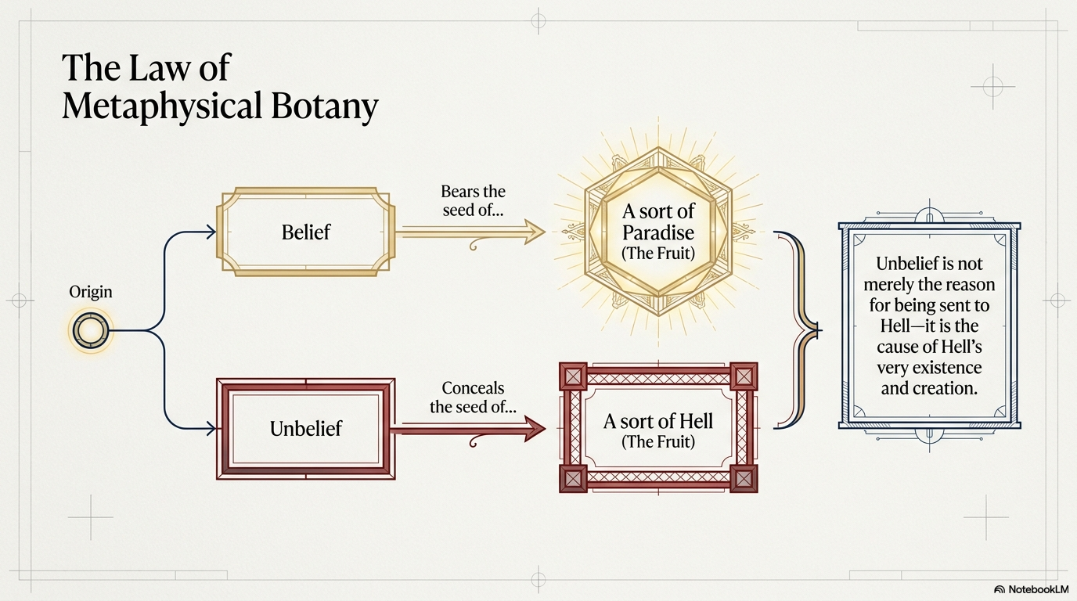
Dersdunyasi.net/en

Slide 3
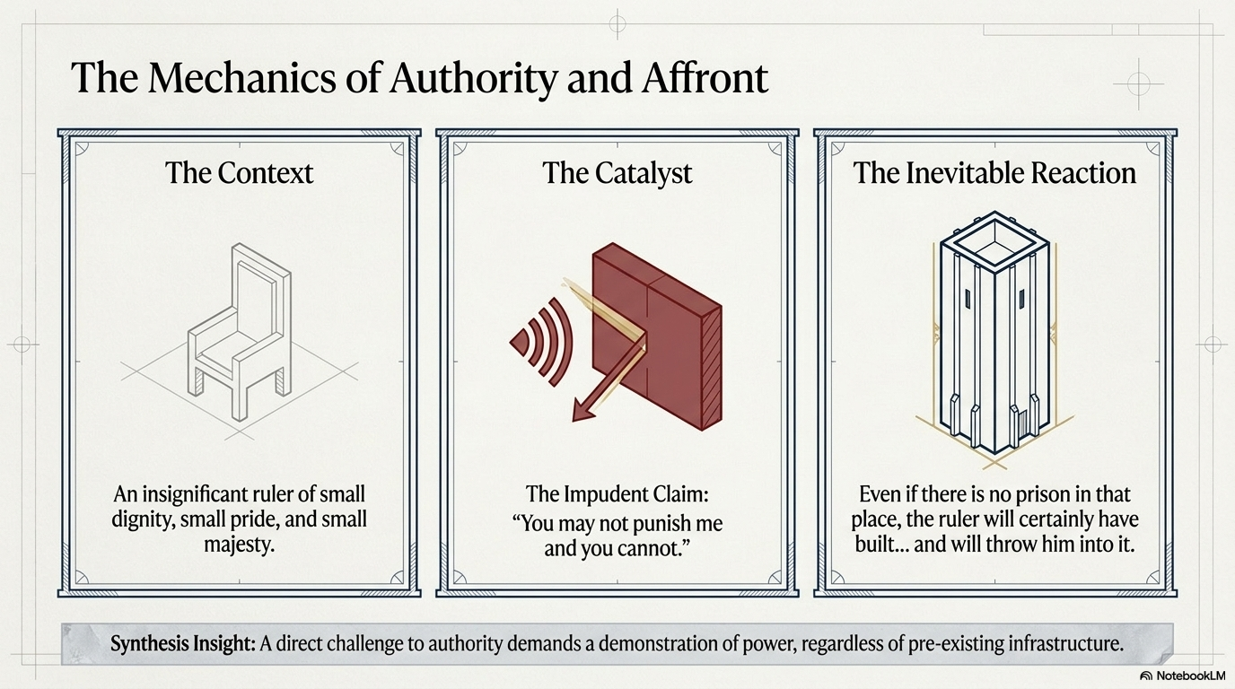
Dersdunyasi.net/en

Slide 4
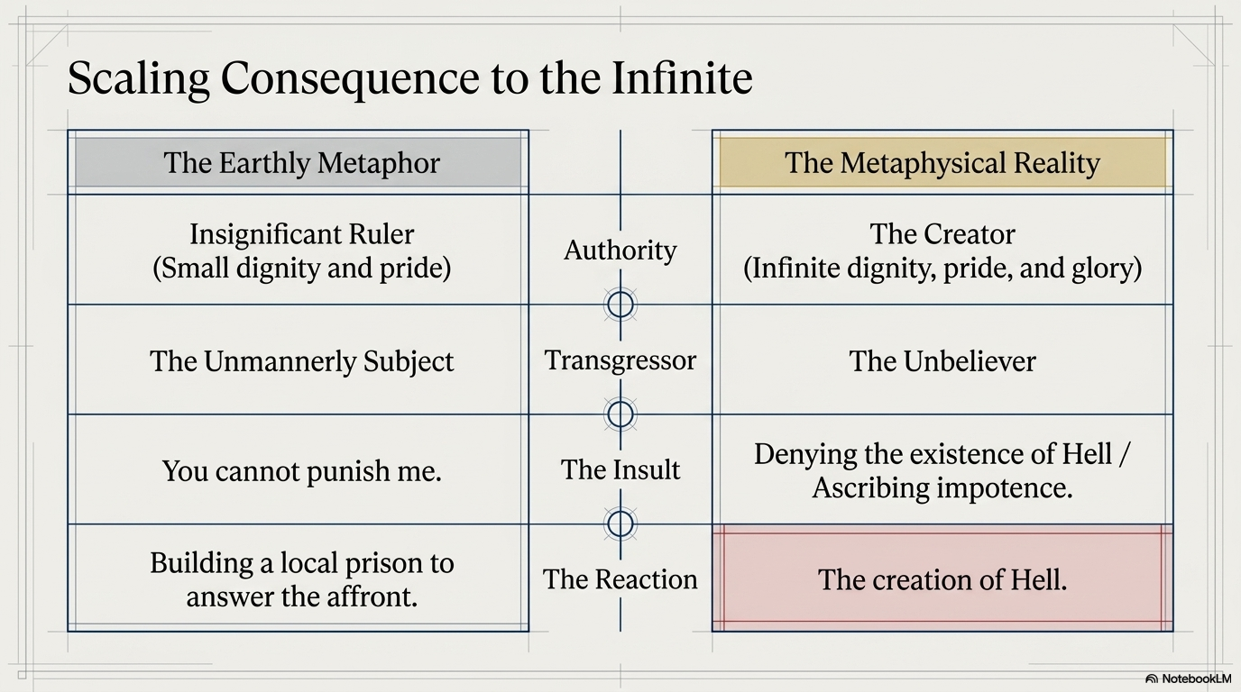
Dersdunyasi.net/en

Slide 5
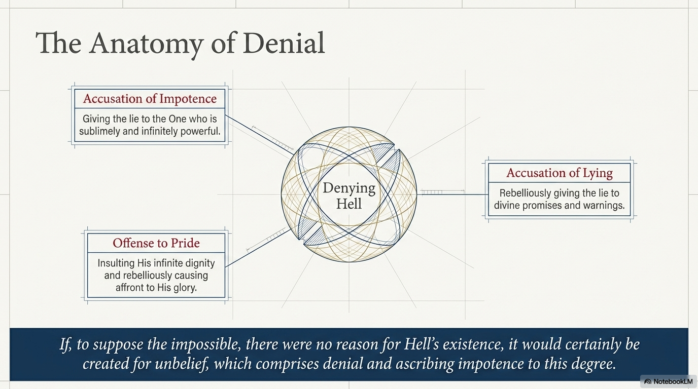
Dersdunyasi.net/en

Slide 6
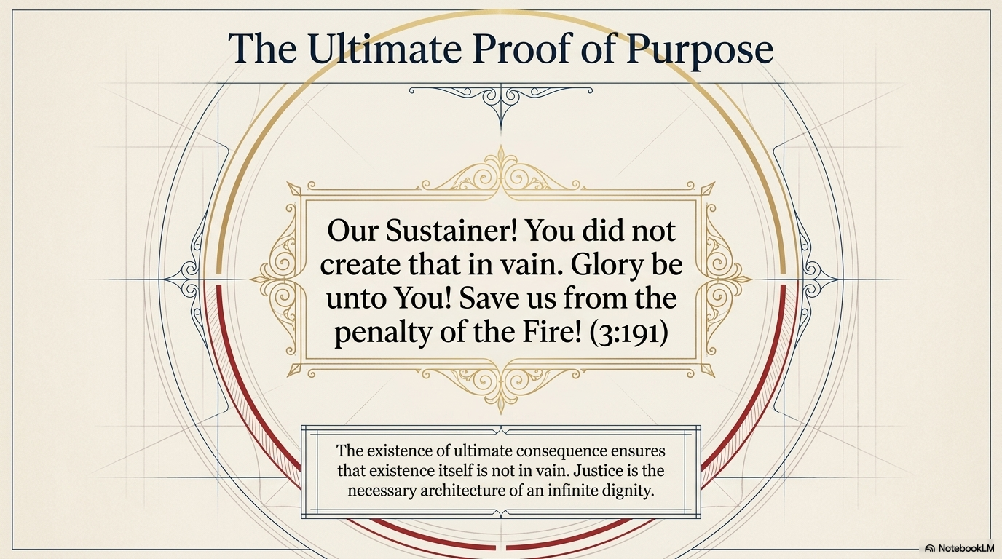
Dersdunyasi.net/en

