Slide 1
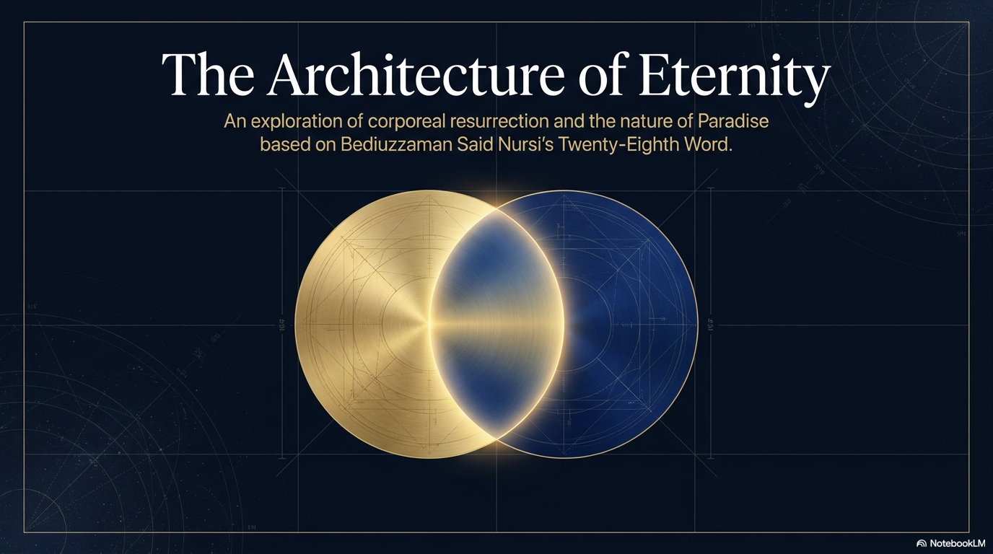

dersdunyasi.net/en

Slide 2
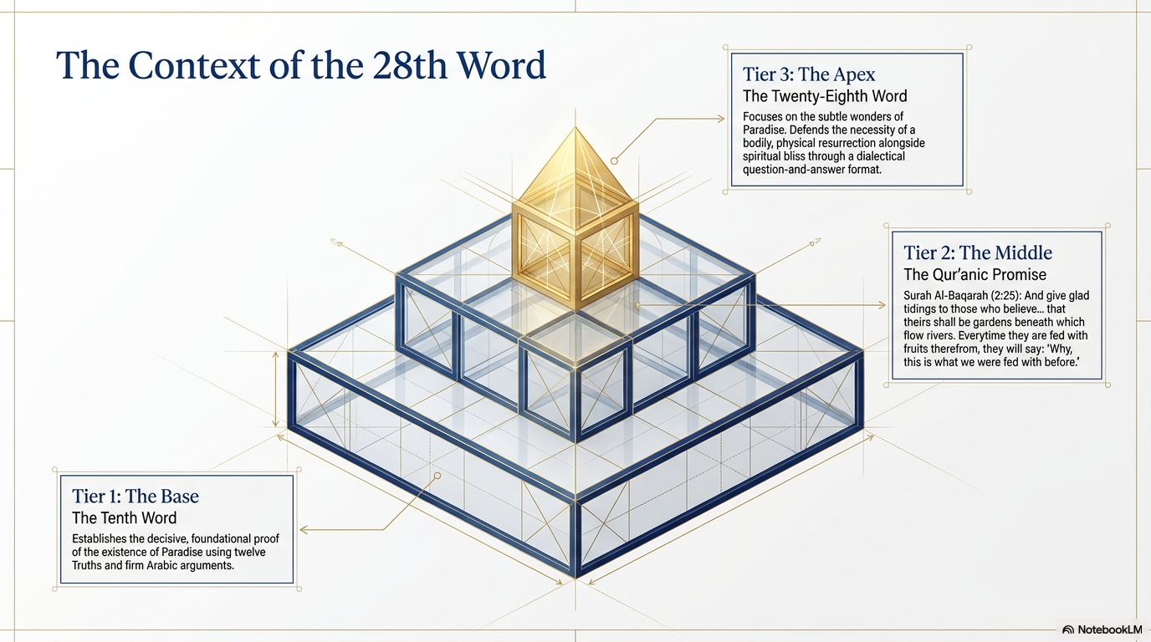
dersdunyasi.net/en

Slide 3
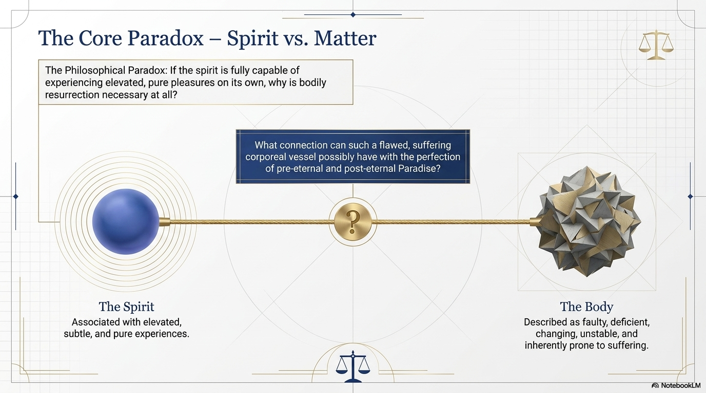
dersdunyasi.net/en

Slide 4
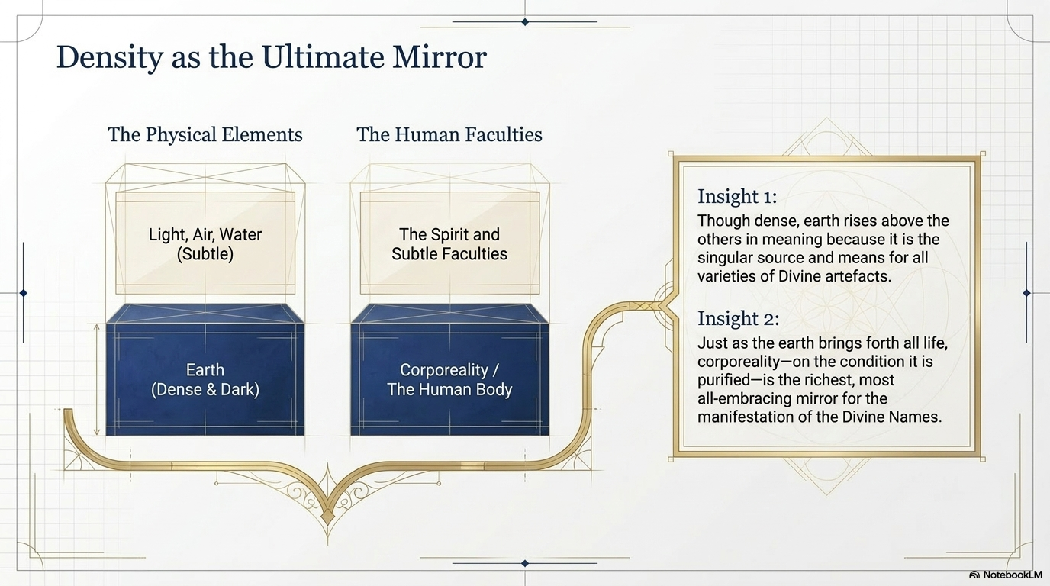
dersdunyasi.net/en

Slide 5
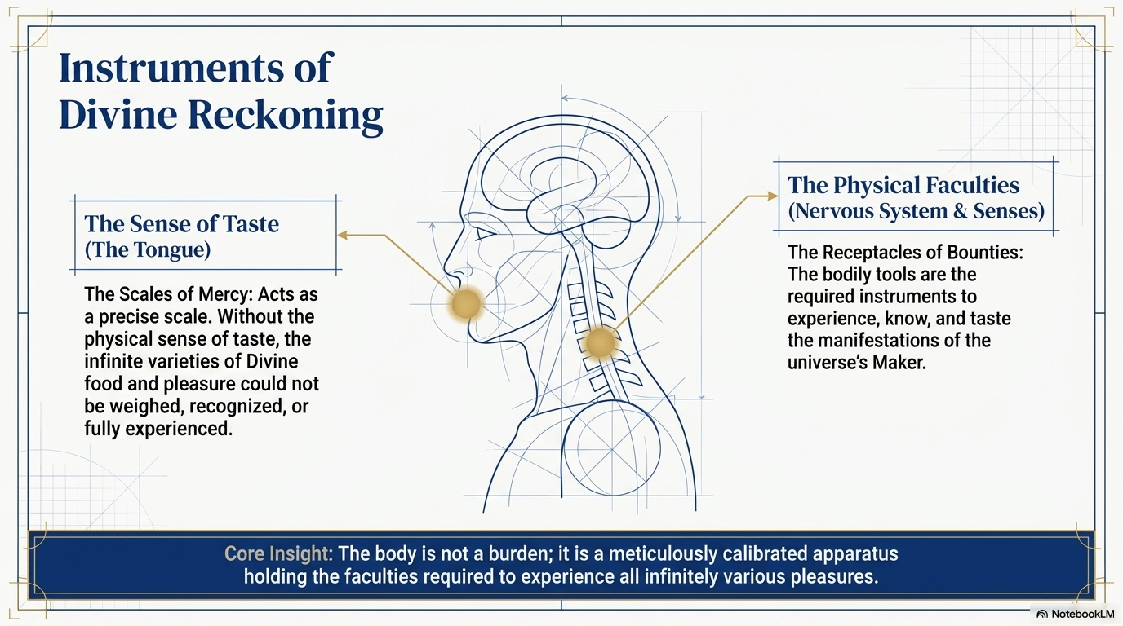
dersdunyasi.net/en

Slide 6
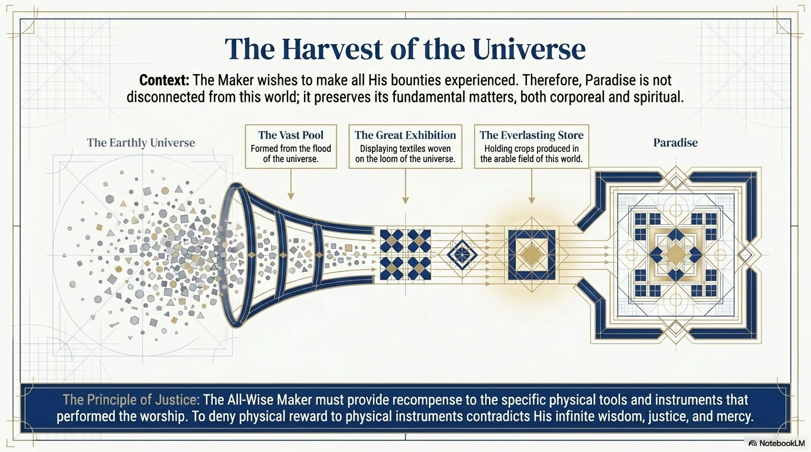
dersdunyasi.net/en

Slide 7
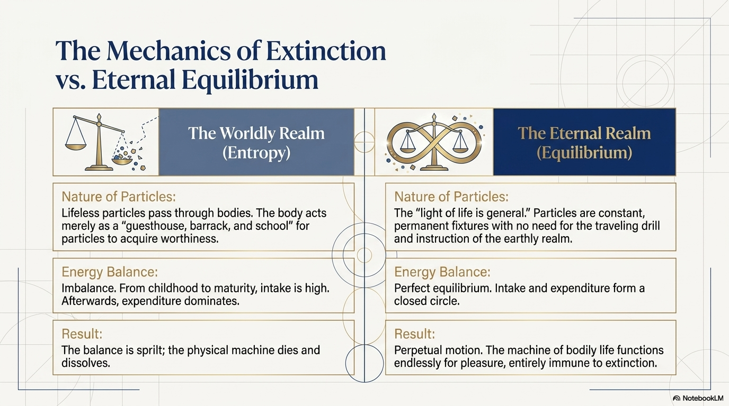
dersdunyasi.net/en

Slide 8
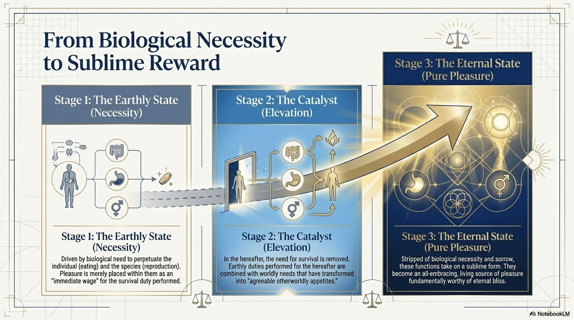
dersdunyasi.net/en

Slide 9
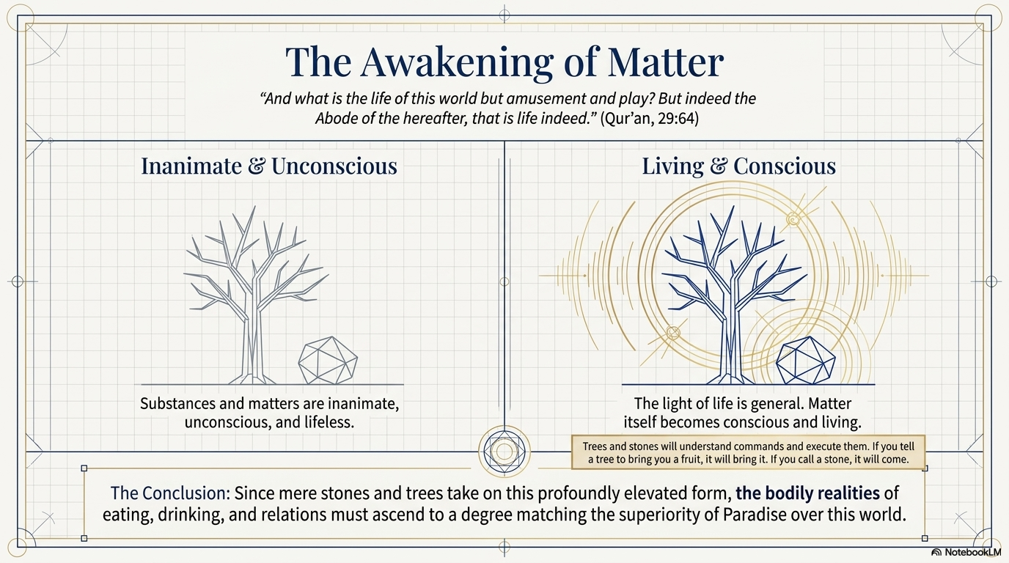
dersdunyasi.net/en

Slide 10
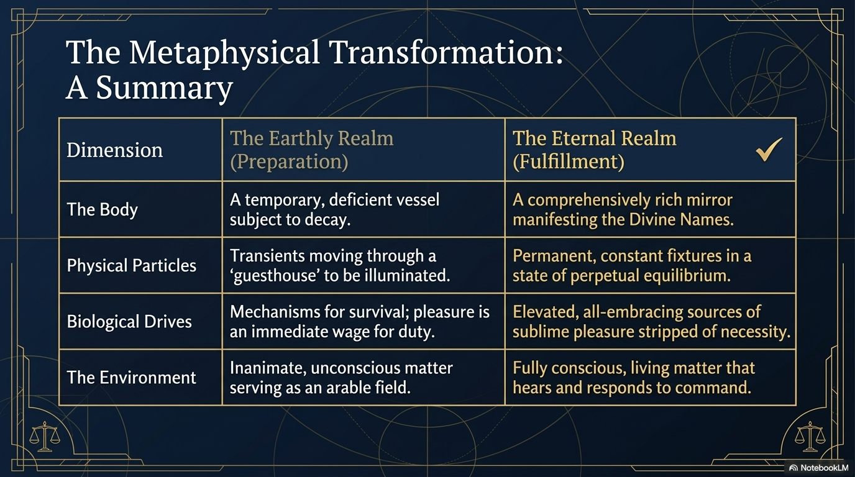
dersdunyasi.net/en

