Slide 1
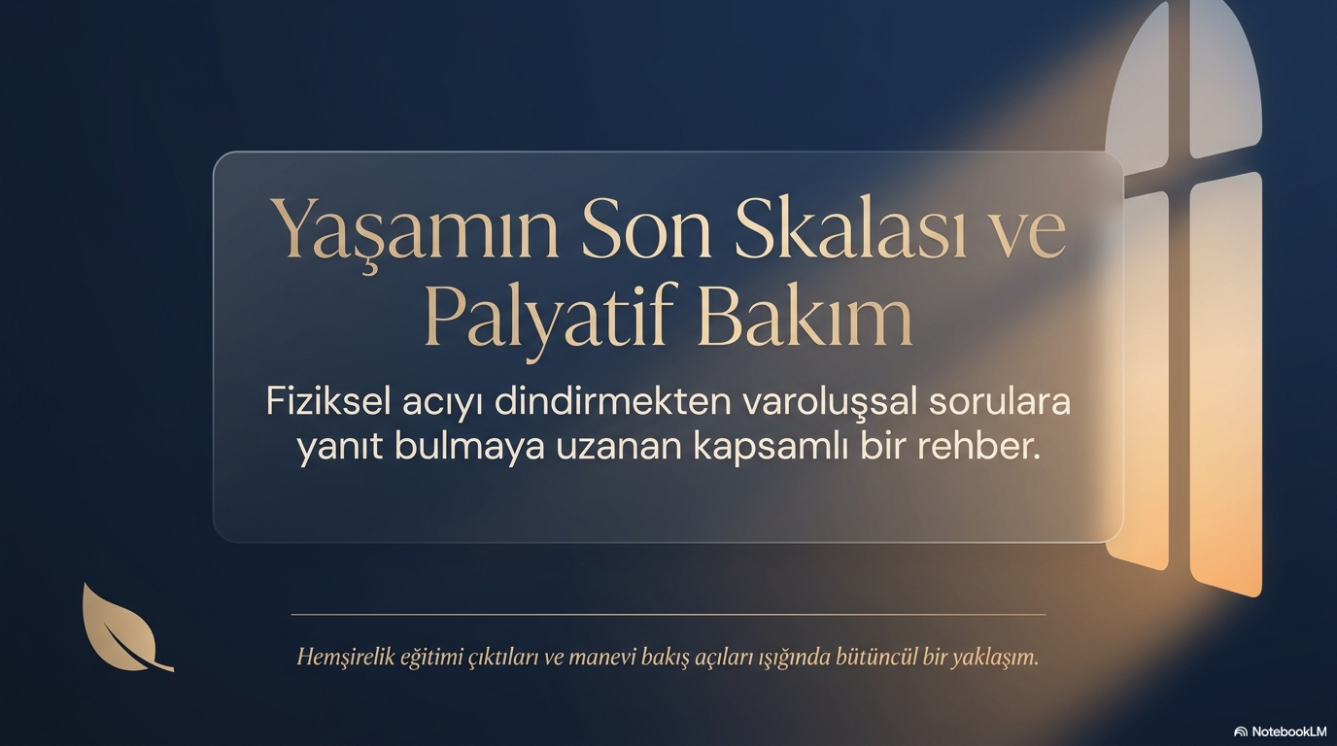

https://dersdunyasi.net/2022/02/28/makaleler/

Slide 2
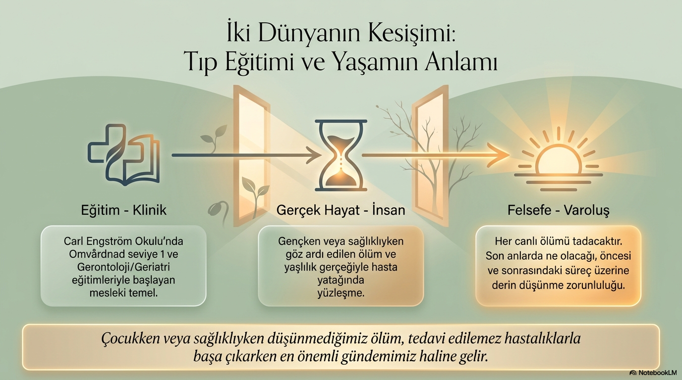
https://dersdunyasi.net/2022/02/28/makaleler/

Slide 3
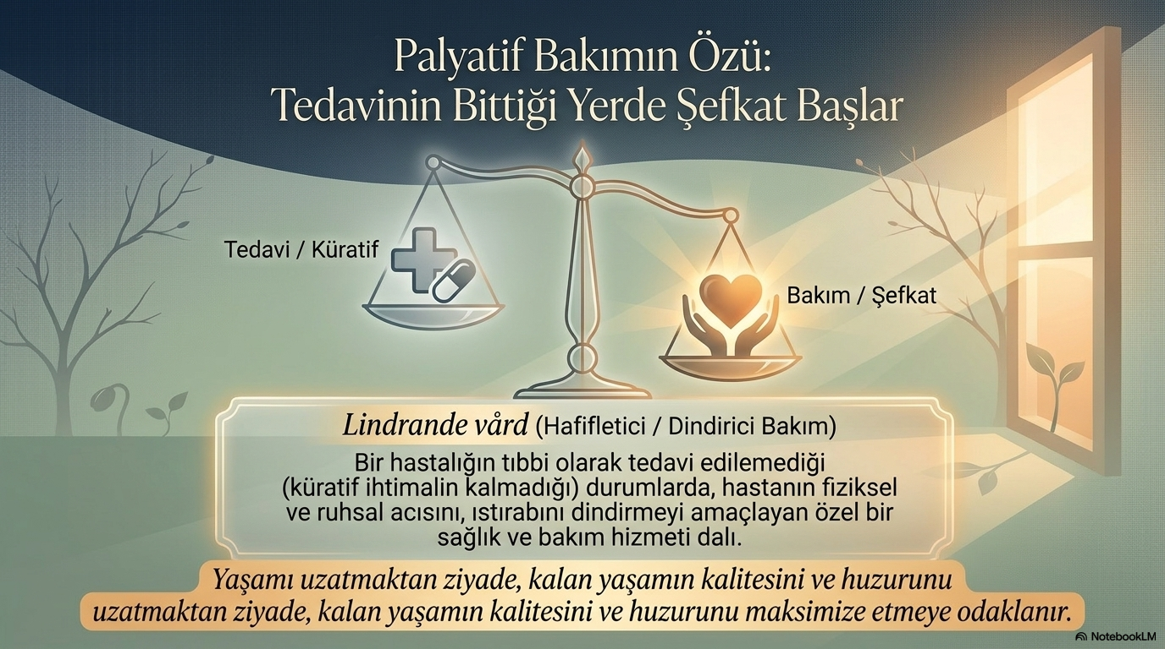
https://dersdunyasi.net/2022/02/28/makaleler/

Slide 4
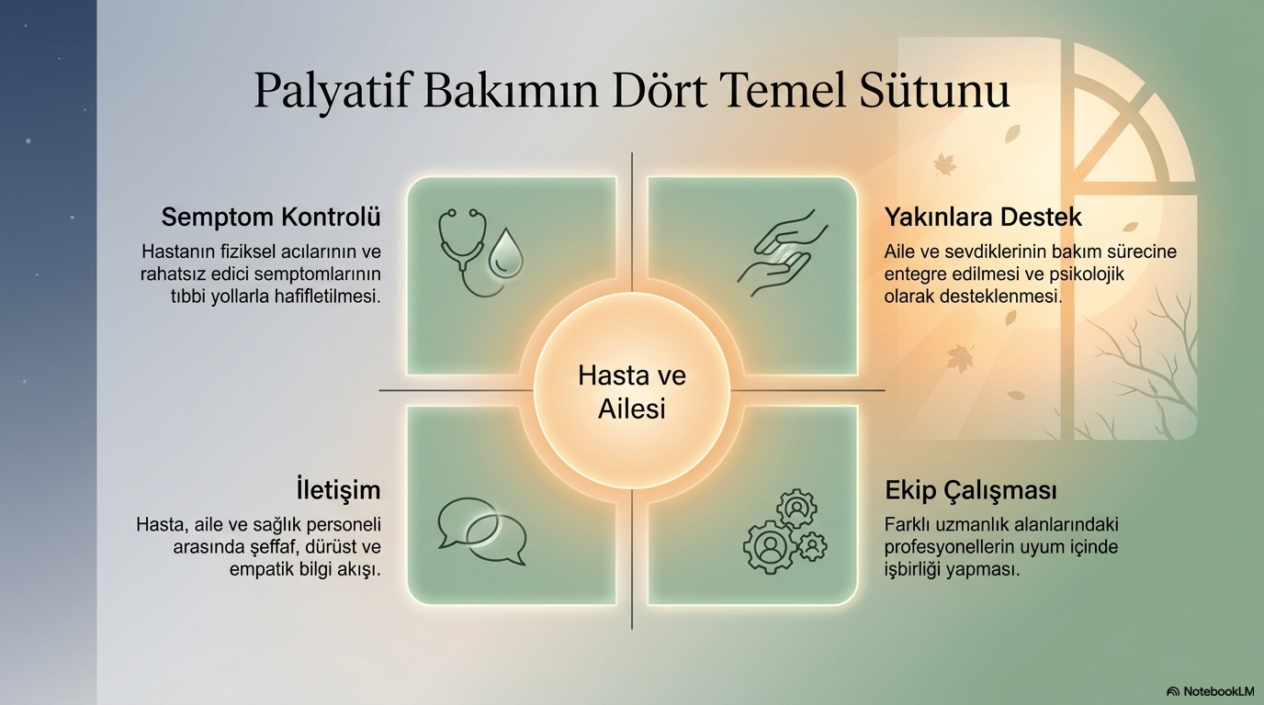
https://dersdunyasi.net/2022/02/28/makaleler/

Slide 5
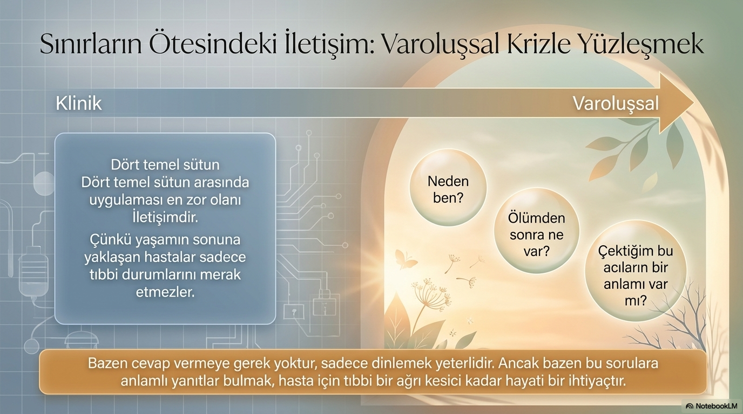
https://dersdunyasi.net/2022/02/28/makaleler/

Slide 6
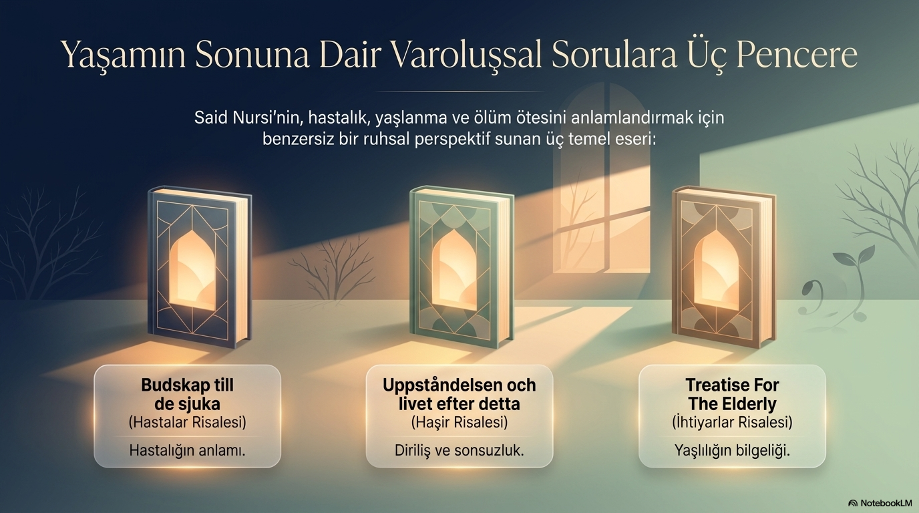
https://dersdunyasi.net/2022/02/28/makaleler/

Slide 7
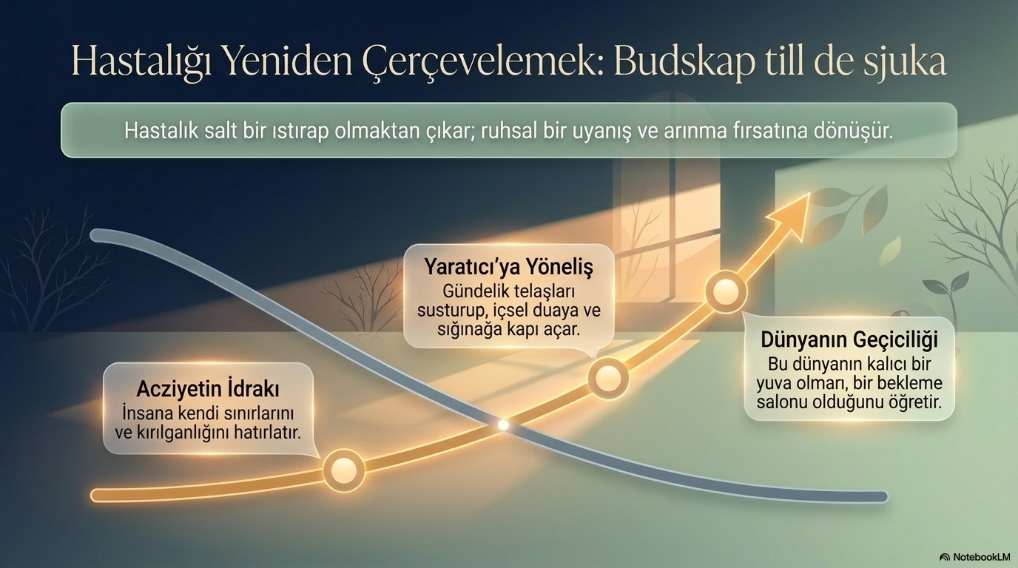
https://dersdunyasi.net/2022/02/28/makaleler/

Slide 8
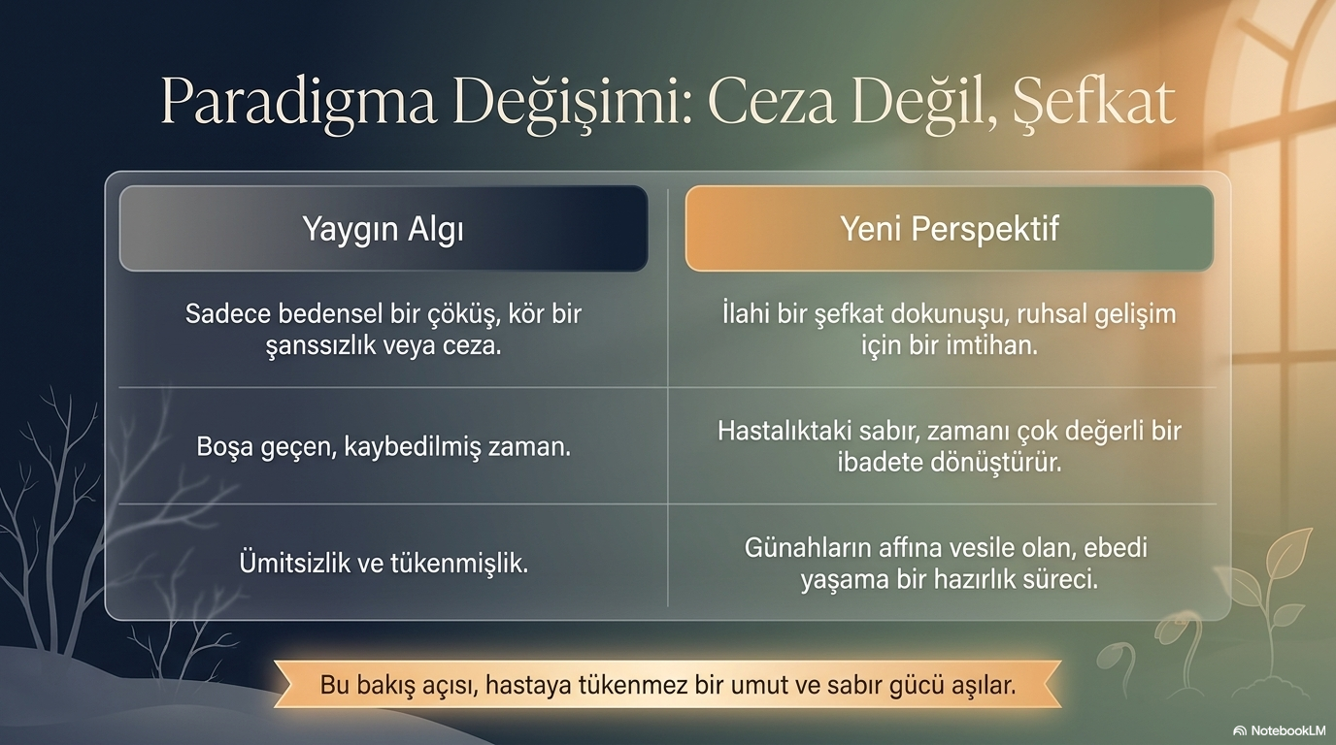
https://dersdunyasi.net/2022/02/28/makaleler/

Slide 9
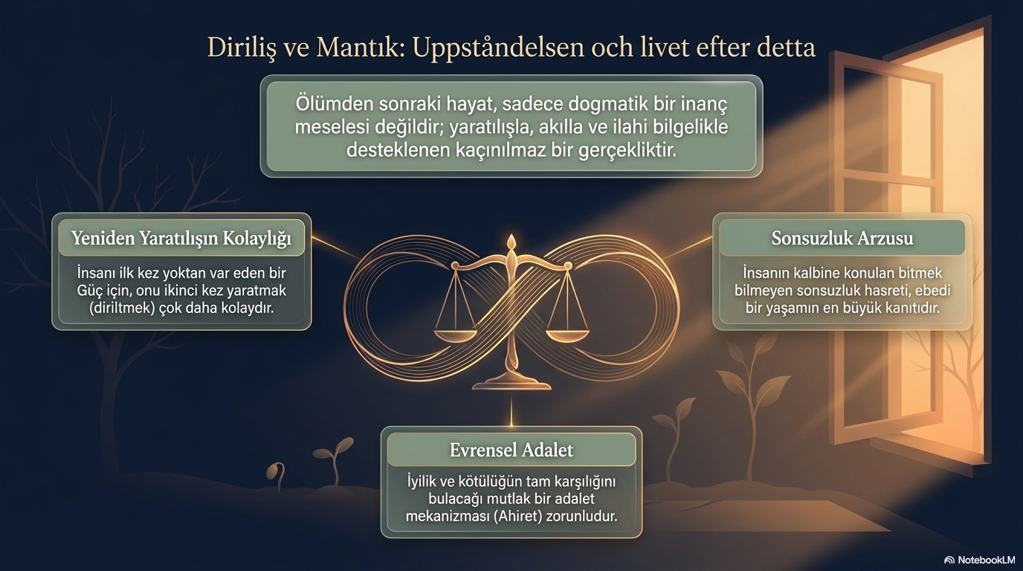
https://dersdunyasi.net/2022/02/28/makaleler/

Slide 10
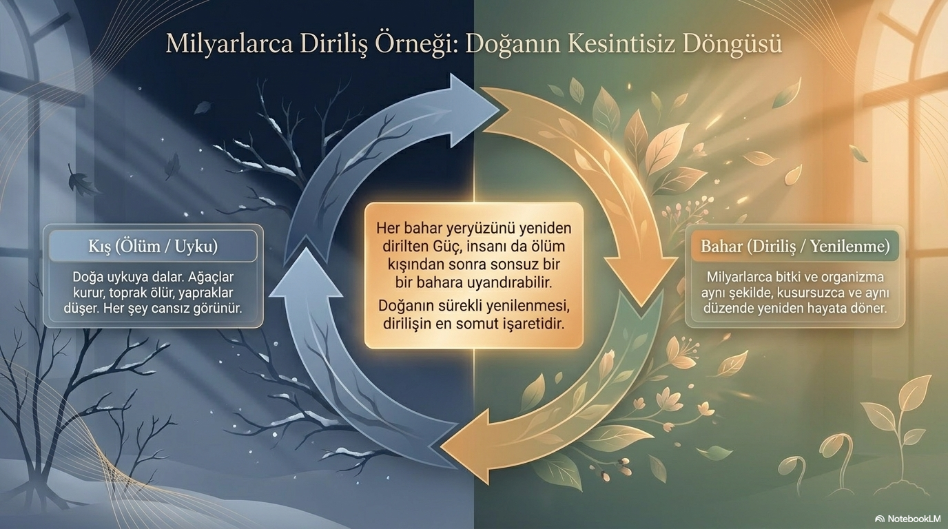
https://dersdunyasi.net/2022/02/28/makaleler/

Slide 11
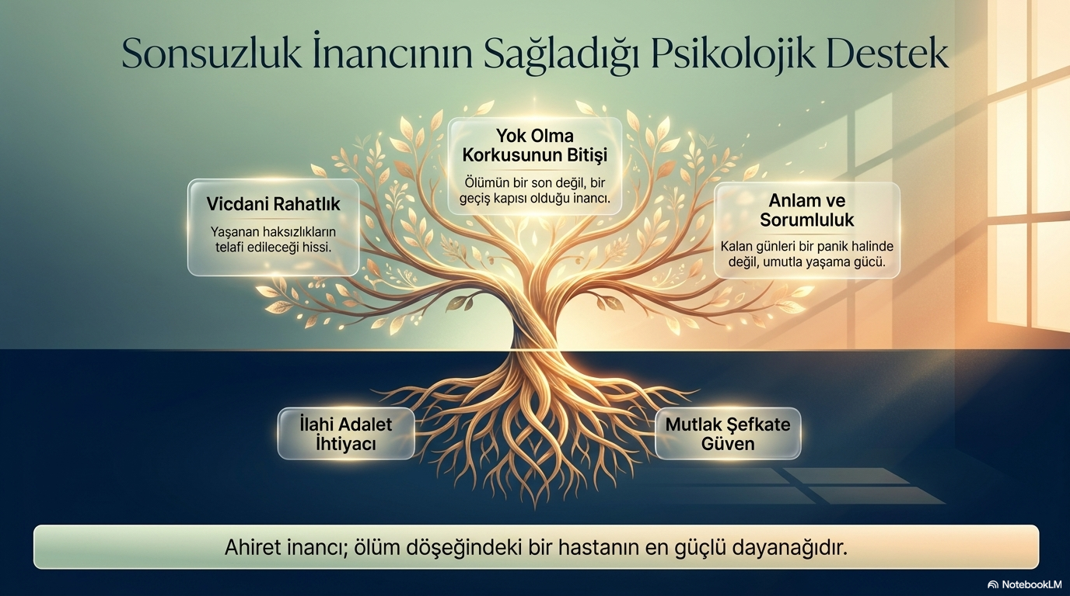
https://dersdunyasi.net/2022/02/28/makaleler/

Slide 12
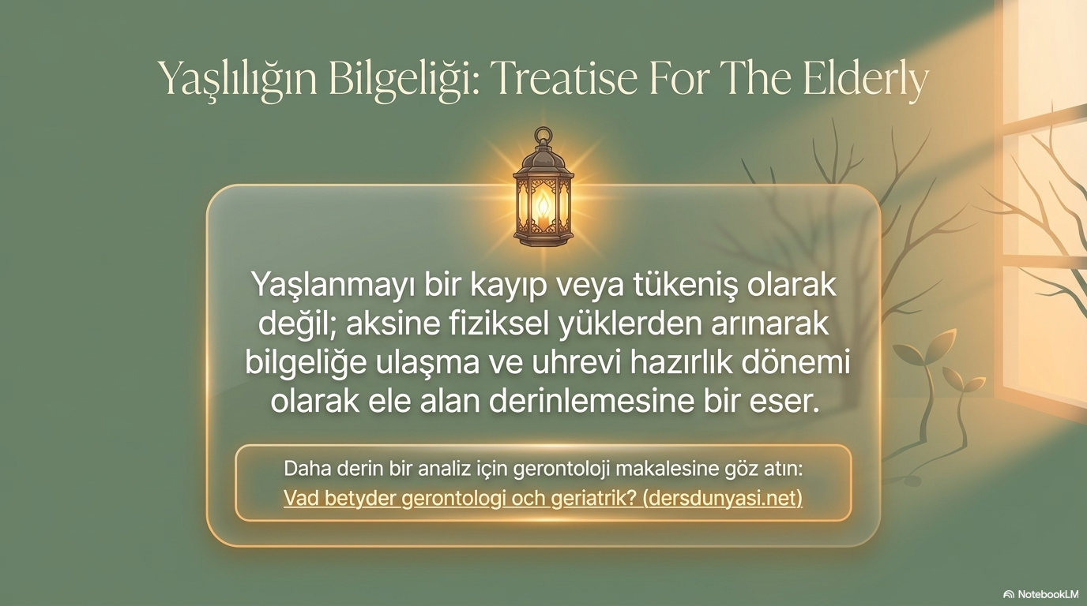
https://dersdunyasi.net/2022/02/28/makaleler/

Slide 13
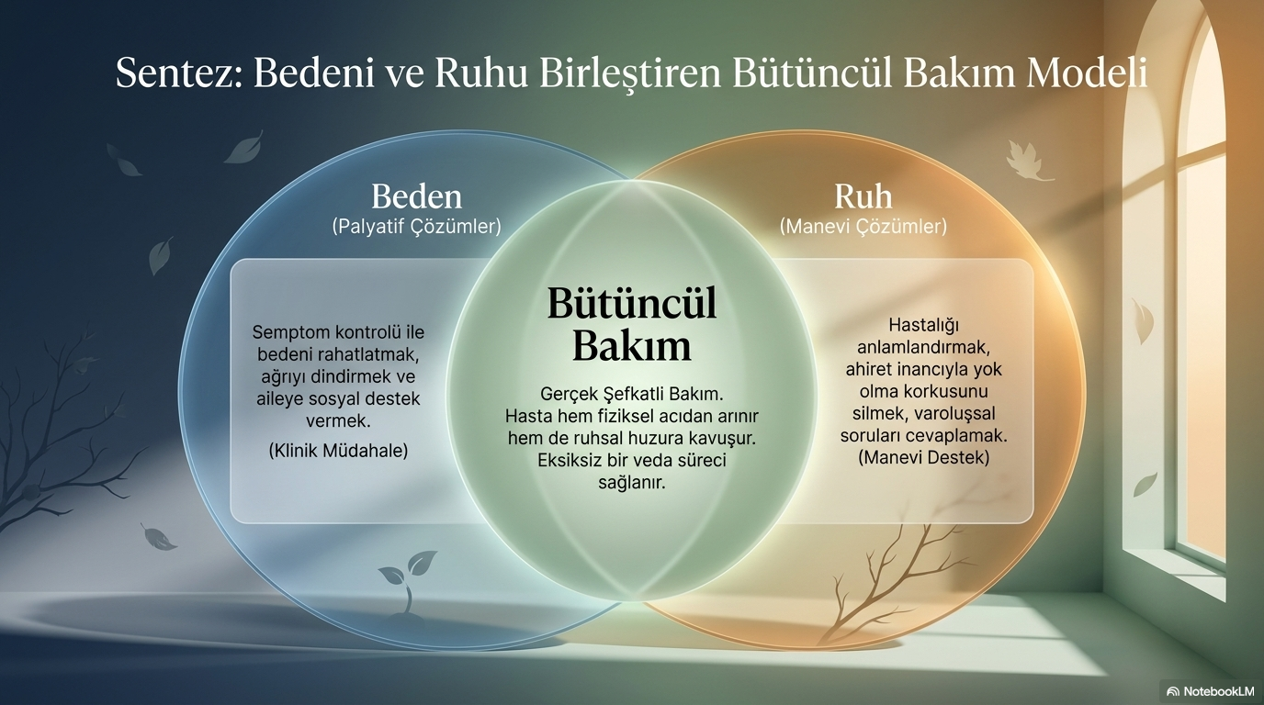
https://dersdunyasi.net/2022/02/28/makaleler/

Slide 14
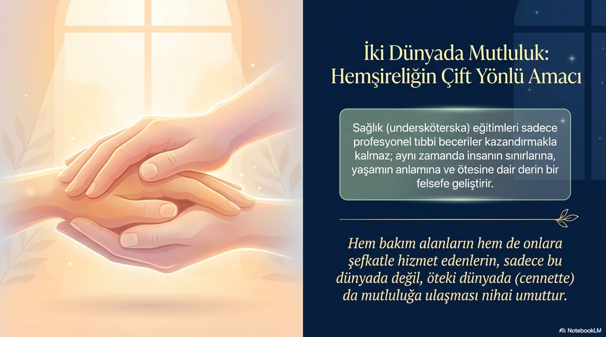
https://dersdunyasi.net/2022/02/28/makaleler/

Slide 15
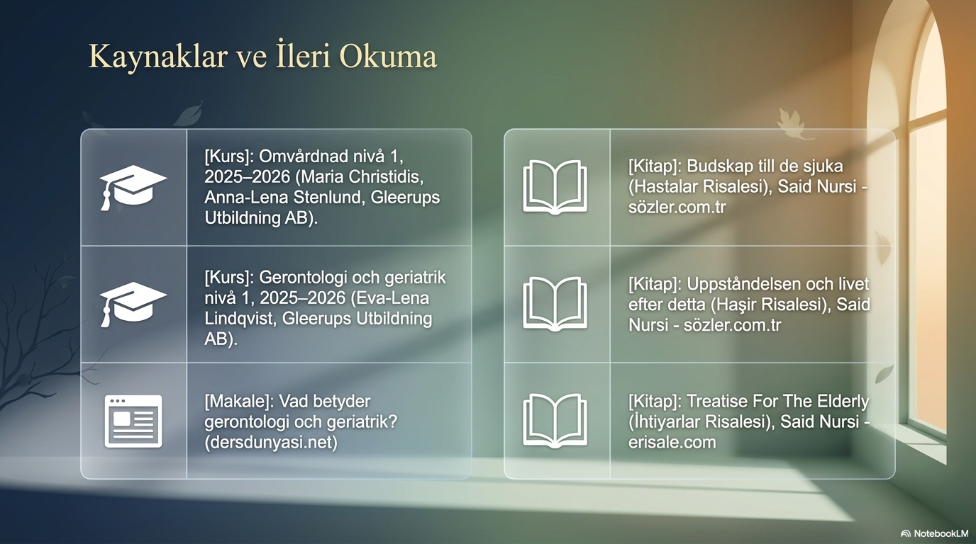
https://dersdunyasi.net/2022/02/28/makaleler/

