Slide 1
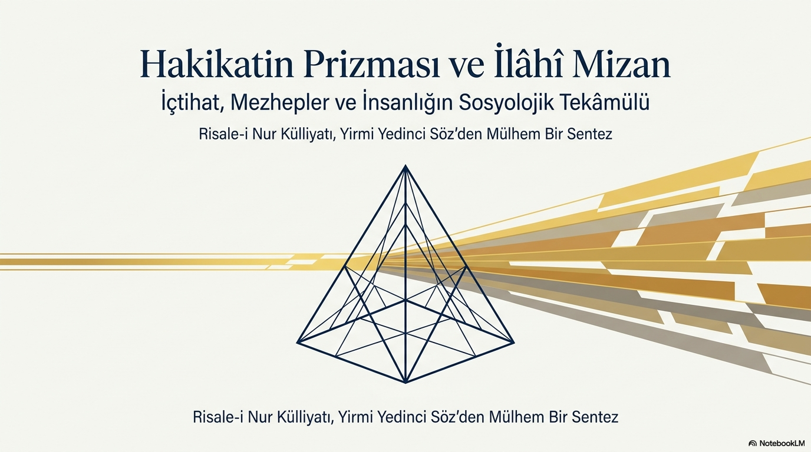

dersdunyasi.net/2022/08/20/cumartesi-dersleri/

Slide 2
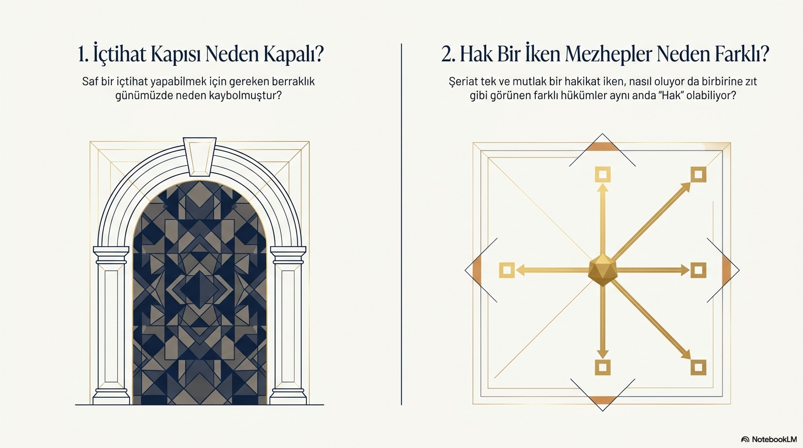
dersdunyasi.net/2022/08/20/cumartesi-dersleri/

Slide 3
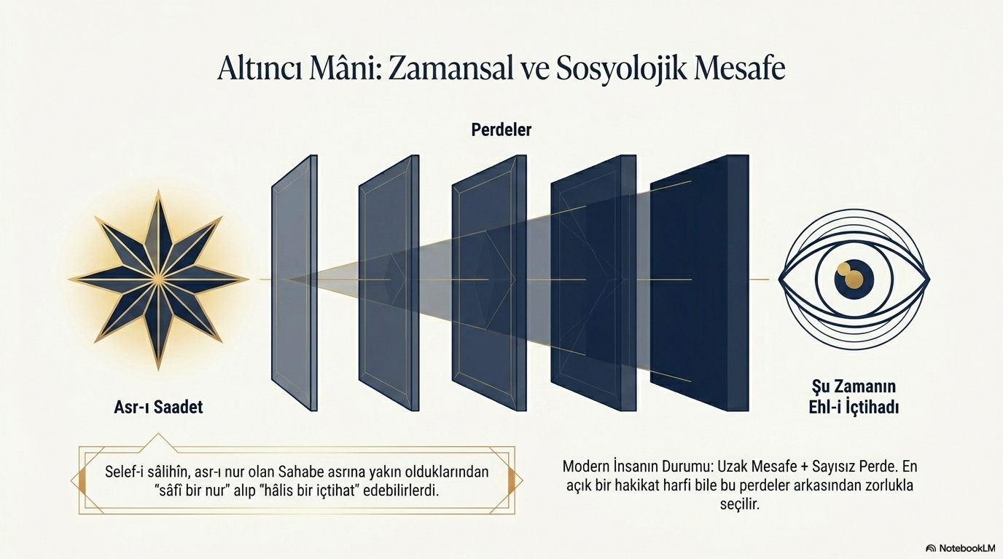
dersdunyasi.net/2022/08/20/cumartesi-dersleri/

Slide 4
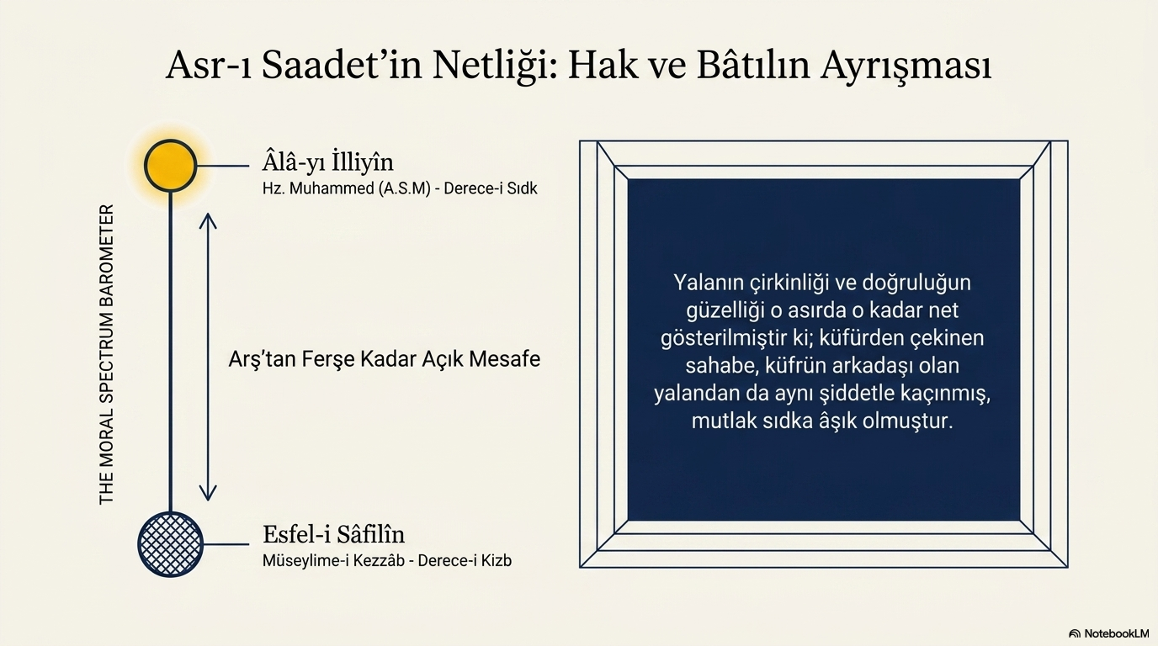
dersdunyasi.net/2022/08/20/cumartesi-dersleri/

Slide 5
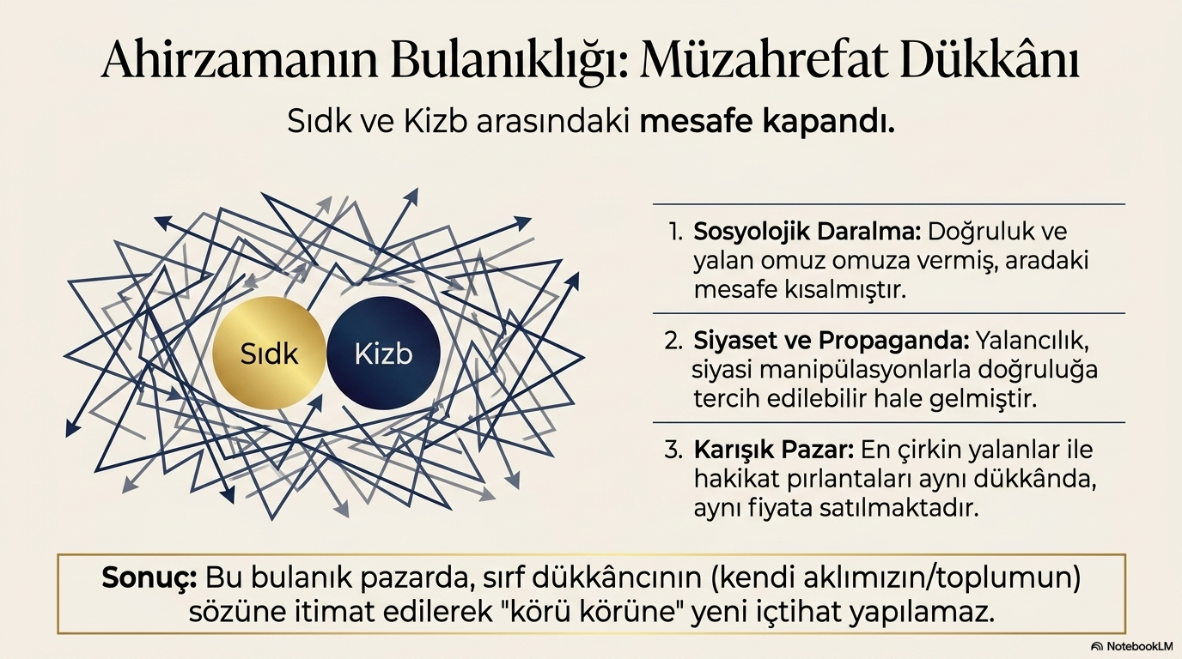
dersdunyasi.net/2022/08/20/cumartesi-dersleri/

Slide 6
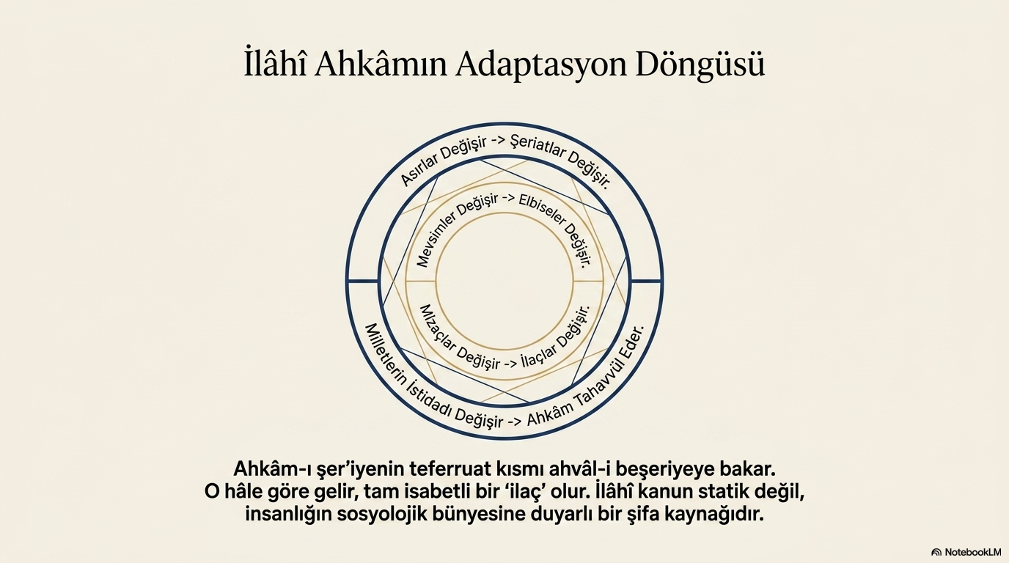
dersdunyasi.net/2022/08/20/cumartesi-dersleri/

Slide 7
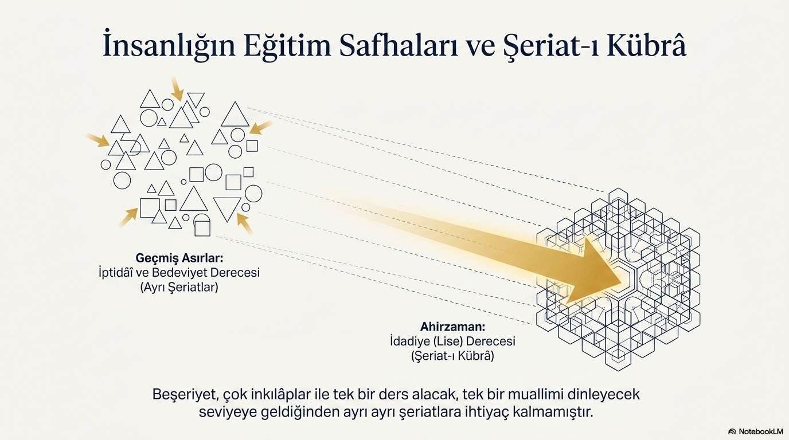
dersdunyasi.net/2022/08/20/cumartesi-dersleri/

Slide 8
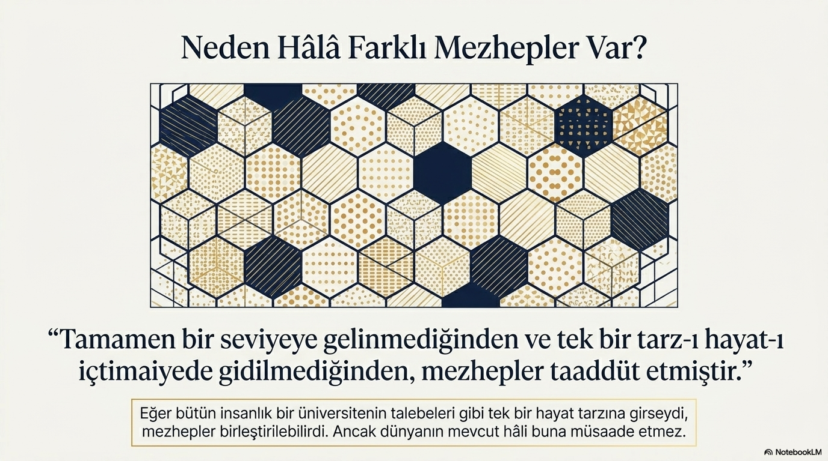
dersdunyasi.net/2022/08/20/cumartesi-dersleri/

Slide 9
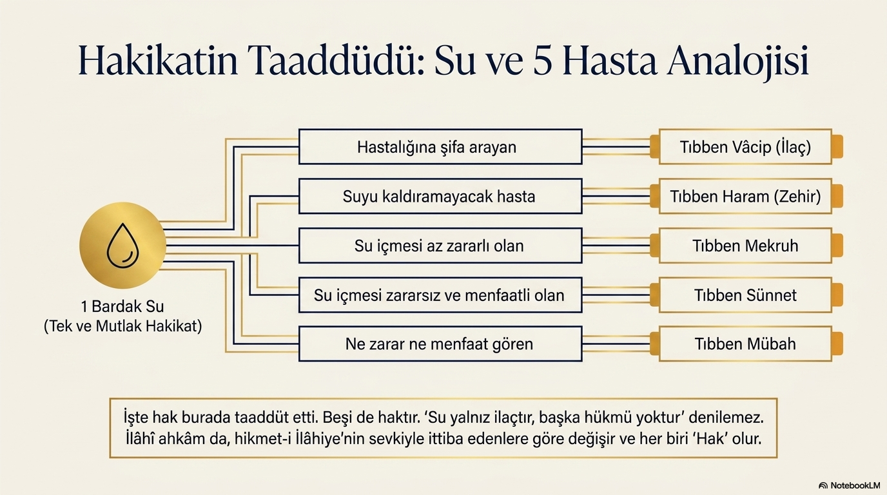
dersdunyasi.net/2022/08/20/cumartesi-dersleri/

Slide 10
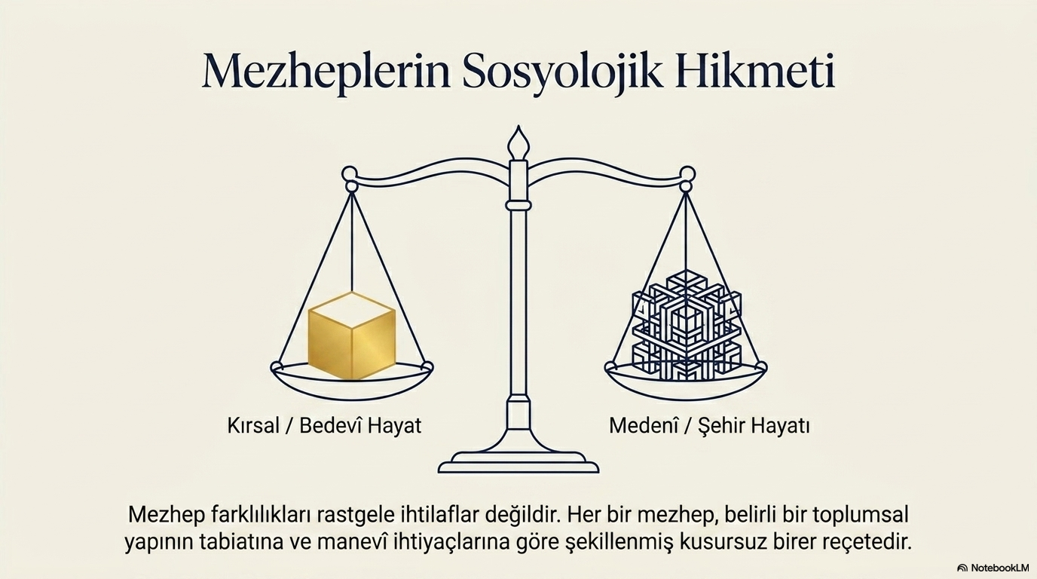
dersdunyasi.net/2022/08/20/cumartesi-dersleri/

Slide 11
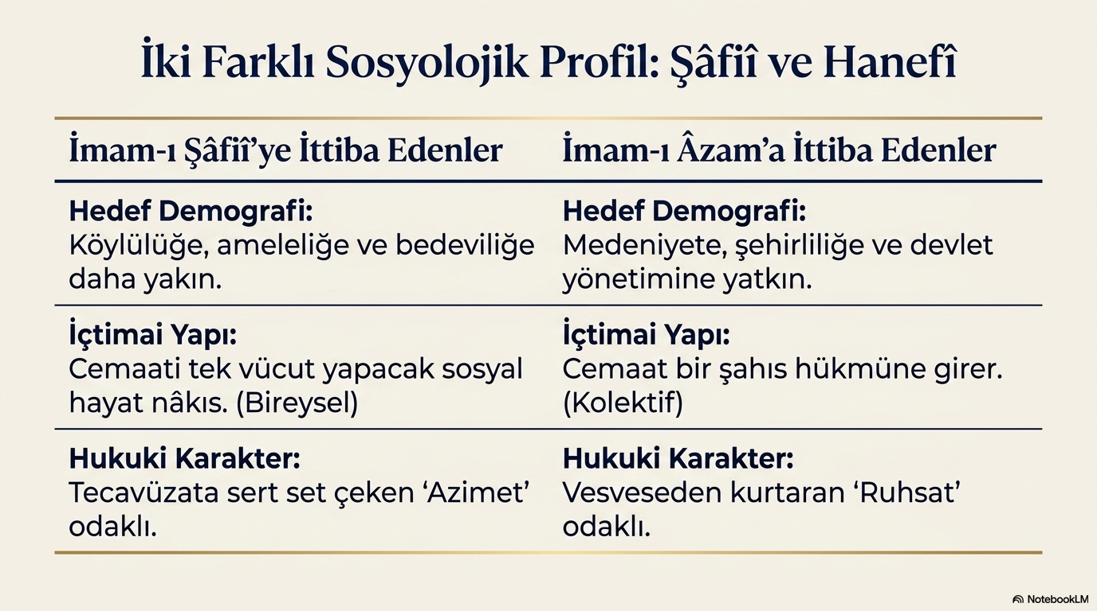
dersdunyasi.net/2022/08/20/cumartesi-dersleri/

Slide 12
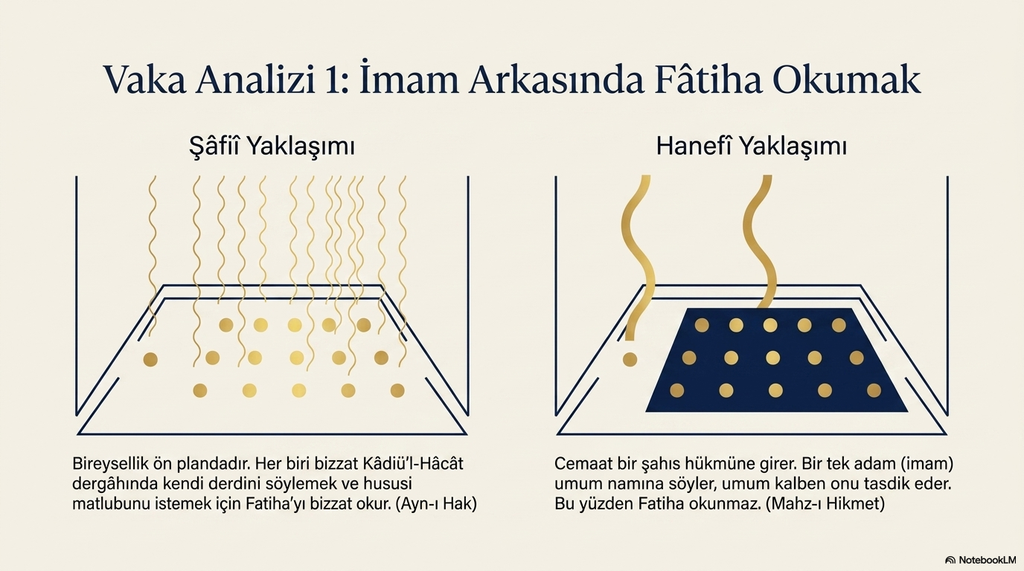
dersdunyasi.net/2022/08/20/cumartesi-dersleri/

Slide 13
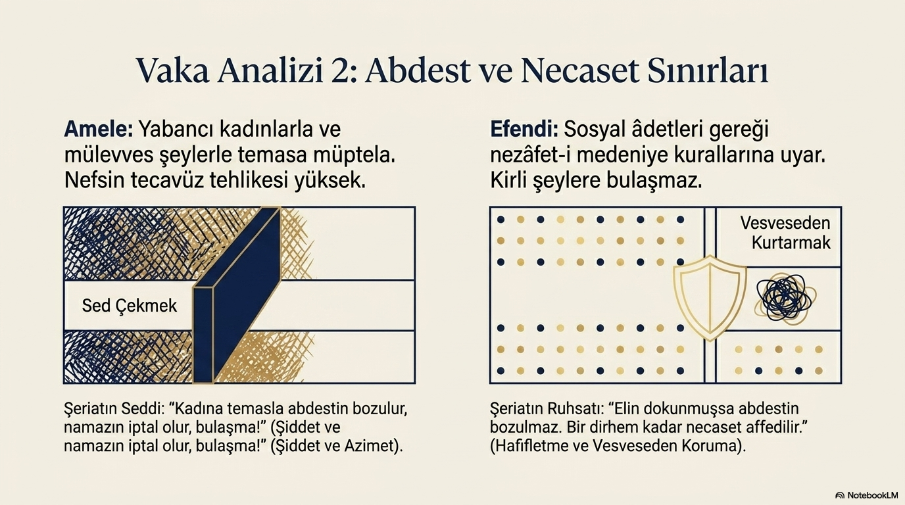
dersdunyasi.net/2022/08/20/cumartesi-dersleri/

Slide 14
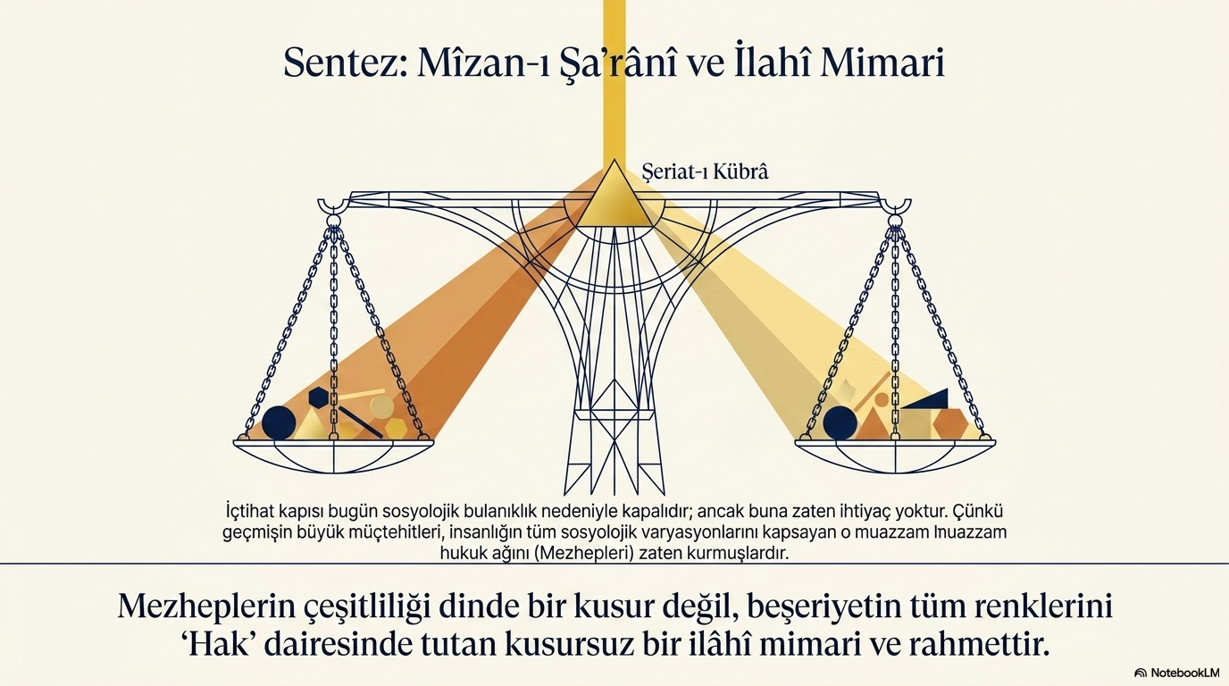

Slide 15
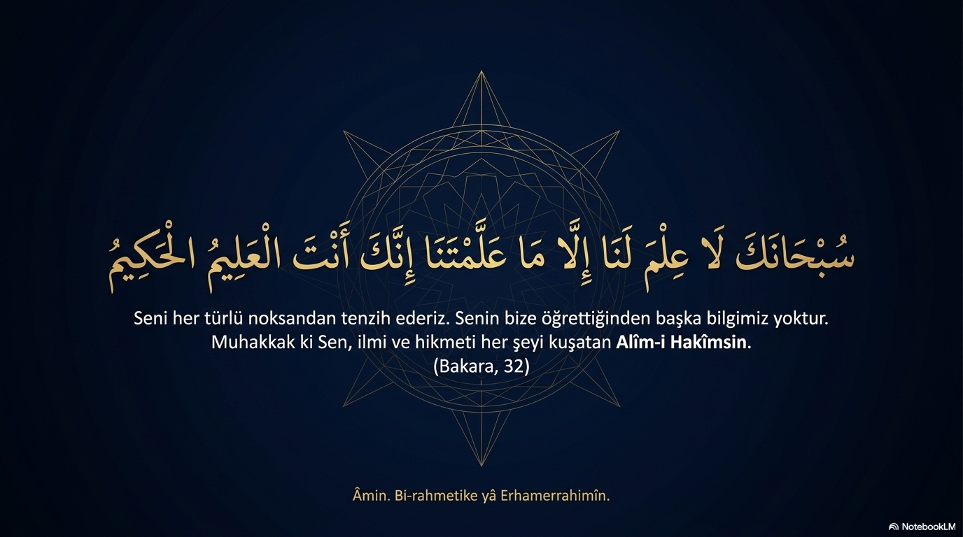
dersdunyasi.net/2022/08/20/cumartesi-dersleri/

